Slide 1
A Window into Alzheimer’s Disease
Lydia Sempsrott

Slide 2
1 in 3 Seniors Dies with Alzheimer’s or Another Dementia
www.alz.org/facts/

Slide 4
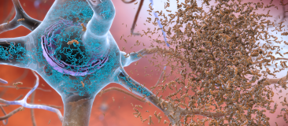
Beta-Amyloid Plaque Buildup between Neurons
Neuron
Beta-amyloid plaque
Image courtesy of the National Institute on Aging/National Institutes of Health

Slide 5
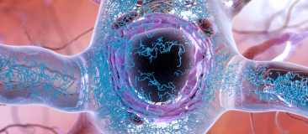
Neurofibrillary Tangles inside a Neuron
Neuron
Tangles of tau protein
Image courtesy of the National Institute on Aging/National Institutes of Health

