Slide 1
Ethics of Designer Children
Molly Pederson

Slide 2
www.ingender.com/Gender-Selection/PGD/

Slide 4
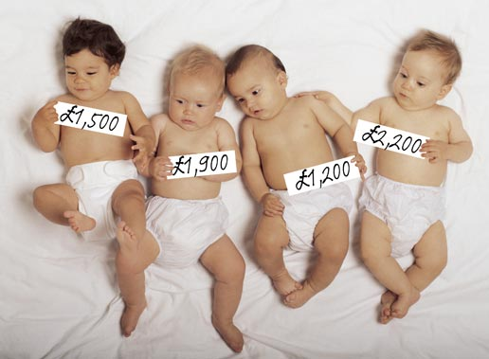
https://i.pinimg.com/originals/54/b0/ae/54b0aeff6469eecd06b801e8d0c55663.jpg

Slide 5
www.simpsonstreetfreepress.org/health/genetic-mutations-ice-age?printable

Slide 6
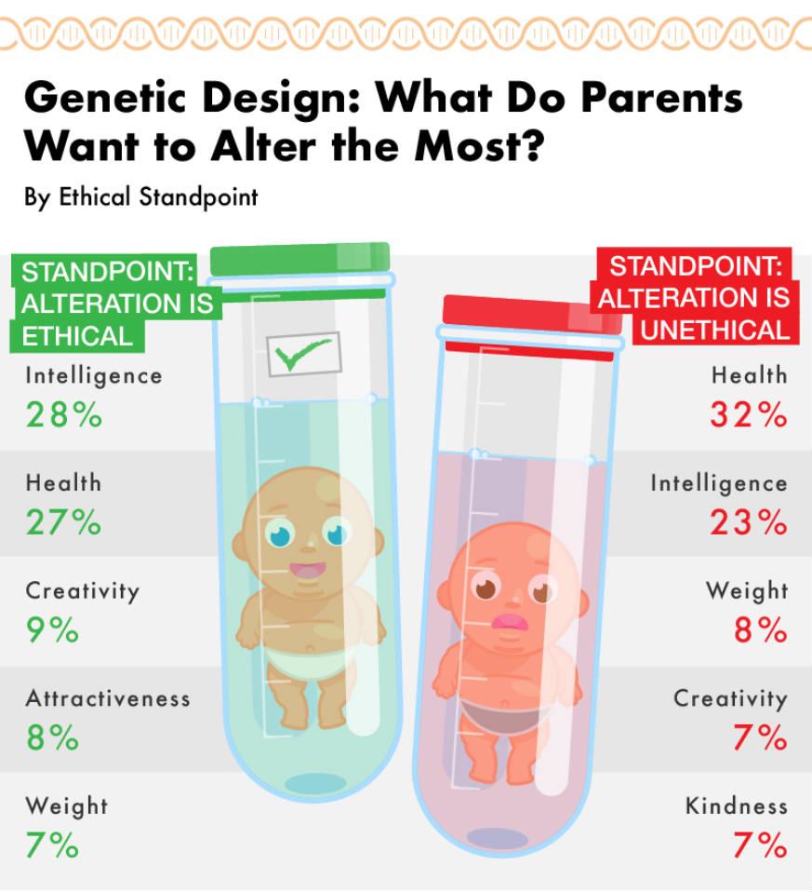
https://www.metro.us/news/todays-debate/gmos-not-food-build-perfect-child-designer-baby

