Slide 1
The Burden of College Debt
Jacob Stewart

Slide 3
Average Debt

Slide 4
Job gains and Losses, Post-2008 Recession

Slide 5
College and Financial Stability
Individuals with Bachelor's degrees gained jobs during the Recession
College Degrees are key to financial stability
Bachelor's degree recipients gained 8.4 million jobs during the recovery
Those without postsecondary education lost 5.6 million

Slide 7
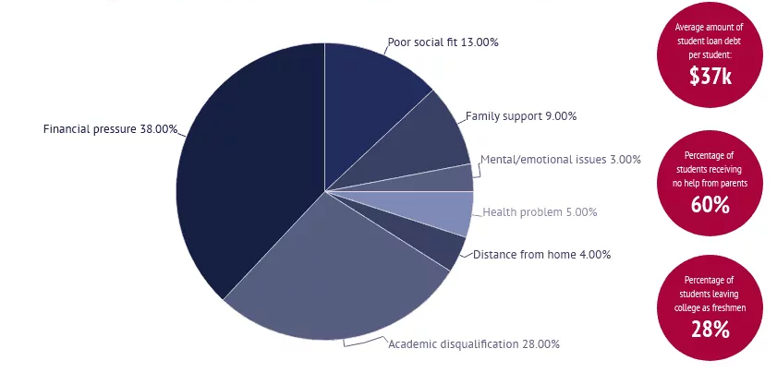
Top Reasons for Dropping out of College

Slide 9
Take a Picture! Scan to Go Debt-Free
Todd Young's Office
317-226-6700
Mike Braun's Office
(317) 822-8240

Slide 10
THANK YOU

